Slide 1



2025
Big Data Foundations
Beatriz Lopes, 20242022
Rita Marques, 20242019
Sara Henriques, 20242070
Soraia Bonnet, 20232047

Slide 2
Goal:
Explore MovieLens Dataset and extract insights
movies
movieId
title
genres
links
movieId
imdbId
tmdbId
ratings
userId
movieId
rating
timestamp
tags
userId
movieId
tag
timestamp
F. Maxwell Harper and Joseph A. Konstan. 2015. The MovieLens Datasets: History and Context. ACM Transactions on Interactive Intelligent Systems (TiiS) 5, 4: 19:1–19:19. https://doi.org/10.1145/2827872
Notes:
Our main purpose is exploring the MovieLens dataset and extract insights

Slide 3
Workflow
1
2
3
4
DuckDB
Query testing using 100k dataset
Trying queries on 32m dataset
Transform csv to parquet
AWS stack
Load 32m parquets in S3
Use AWS Glue crawler
Do ‘heavy’ join in Athena
Export results: summary table per movie
Python + Polars
Ask questions about the data
Perform visualizations to answer these questions
Present insights!
What we are doing right now ;)

Slide 4
Report-worthy details
The next few slides summarize our approach using a topic layout as a reporting method.

Slide 5
DuckDB workflow
We started with the 100K dataset, and moved to the 32m dataset, focusing on the question:
What are the factors (genre, number of ratings, and popularity) that influence the average ratings in MovieLens?
Calculated total number of movies (87585), users (200948), and ratings (32m)
Calculated number of movies per genre (unnested genres, grouped by genre, and counted movies)
Calculated the rating distributions per movie (total number, mean, median, standard deviation, and variance) using a join between movies and ratings. Got the movies with the largest average rating.
Calculated average ratings per genre (grouped by genre, averaged rating)
Calculated the years with the best ratings (extracted year, grouped by year, averaged ratings)

Slide 6
AWS workflow
Uploaded parquet table files in separate folders to AWS S3 bucket, and created a new bucket to hold the query results.
Used AWS Glue’s crawler to populate the data catalogue (obtain schemas).
Used AWS Athena to run the following query on the 32m dataset:
SELECT movies.movieId, movies.title, movies.genres, AVG(ratings.rating) AS average_rating, COUNT(ratings.rating) AS rating_count, COUNT(tag."movieId") as tag_count_per_movie, COUNT(DISTINCT ratings."userId") as user_count_per_movie
FROM movies
left join ratings on movies."movieId" = ratings."movieId"
left join tag on movies."movieId" = tag."movieId"
GROUP BY movies.movieId, movies.title, movies.genres
These joins helped summarize the large ratings table, and the query failed to run locally in DuckDB (>20min wait), hence why we tried the AWS stack, which worked like a charm.
Obtained moviedetails.csv

Slide 7
Python + Polars workflow
Imported 32m parquet datasets and AWS moviedetails.csv output using Polars (it was faster than pandas).
For the analyses, we considered movies with >50 ratings only.
The (no genres listed) genres category was turned into ‘None’.
401 movies shared titles, albeit with different movieIDs and genres. We concluded that they indeed correspond to different entries in IMDb, so these remained separated.
Year was extracted from Movie titles, and genres were exploded.
Converted timestamp to a datetime using the seconds since midnight (UTC) of January 1st, 1970.
We inspected whether the same user can make multiple ratings on a single movie. This occurrence is not present in the dataset.
However, the same user can add multiple tags to the movie.

Slide 8
Python + Polars workflow (continuation)
Movie rows with missing values were dropped (3153 had no ratings, 615 had no year, 7080 had no genres)
For data understanding, we began by examining which factors explain higher ratings, focusing on genre, popularity, and user behaviour. In detail, we looked at how ratings vary by genre, how the number of ratings relates to perceived quality, and whether highly active users evaluate films differently from casual ones.
Additionally, we used a publicly available IMDb dataset to inspect the relationship between quality and movie duration.
The study then extended to a temporal dimension, analysing how user engagement and film preferences evolved during key global events, such as the COVID-19 pandemic (declared March 11, 2020), to explore whether confinement and increased screen time affected the volume or sentiment of ratings.
Together, these analyses connect user-level behaviour with larger social contexts, revealing how intrinsic factors — such as genre and popularity — consistently shape evaluations, while external events can briefly shift what audiences choose to watch without fundamentally changing how they rate films.

Slide 9
Conclusions
The analysis of the MovieLens 32M dataset shows that movie ratings are driven mainly by genre, number of ratings, and film popularity.
Genre remains the most decisive factor: Documentary, Film-Noir, and IMAX consistently achieve the highest average scores, whereas popular mainstream genres such as Drama, Action & Thriller attract larger audiences. Popularity itself seems to act as a stabilizer — the more ratings a movie receives, the more moderate its final average becomes.
User activity patterns are equally revealing. Even the most prolific users rate films with similar distributions to casual viewers, suggesting that the platform supports a balanced and consistent evaluation culture rather than bias from recurrent users.
The temporal dimension highlights how external events can momentarily shape audience focus without deeply altering evaluation standards. During the COVID-19 pandemic, platform activity and movie accessibility grew sharply, as people turned to films for comfort and connection during lockdown times. Overall, user behaviour reacts to global circumstances but quickly returns to its steady patterns.
Looking ahead, with more user-centered data, this study could be extended towards a recommendation engine by developing a movie filtering model to recommend movies based on preferences from similar users. Integrating semantic movie tags and metadata could further enhance predictions, allowing richer representations of content beyond the genre category. This combination would bridge statistical modelling with human interpretation, enabling a deeper understanding of how people engage with cinema across time and context.

Slide 10
Questions
What are the most popular genres?
What are the highest-rated genres?
What is the relationship between popularity and quality?
How have movie ratings evolved?
How have movie genres evolved over the decades?
Who are the most active reviewers?
Do the most active users tend to give higher or lower ratings?
Do longer movies receive higher or lower ratings?
Did user behaviour change around the COVID-19 pandemic?
Did people remember a movie with a COVID-like plot during the pandemic?
Notes:
Maybe add in best movies ever?

Slide 11
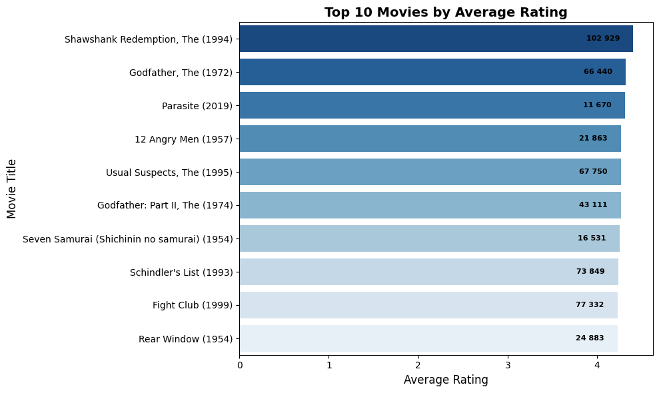
Best movies

Slide 12

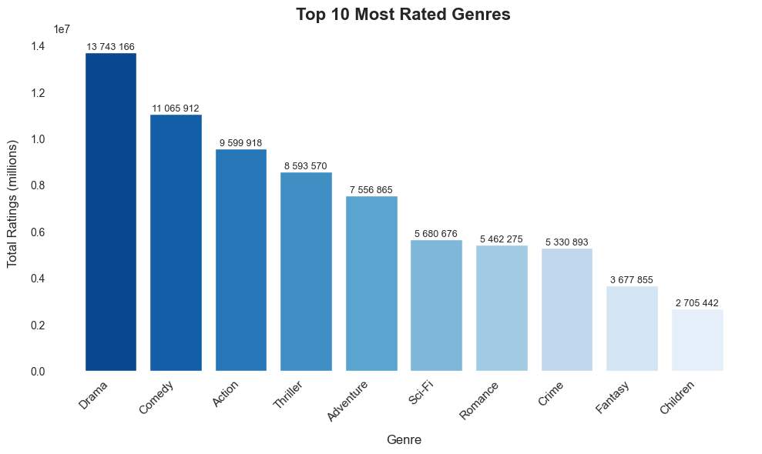



Drama is the most popular genre
What are the most popular genres?
Followed by:
- Comedy
Action
Thriller

Slide 13

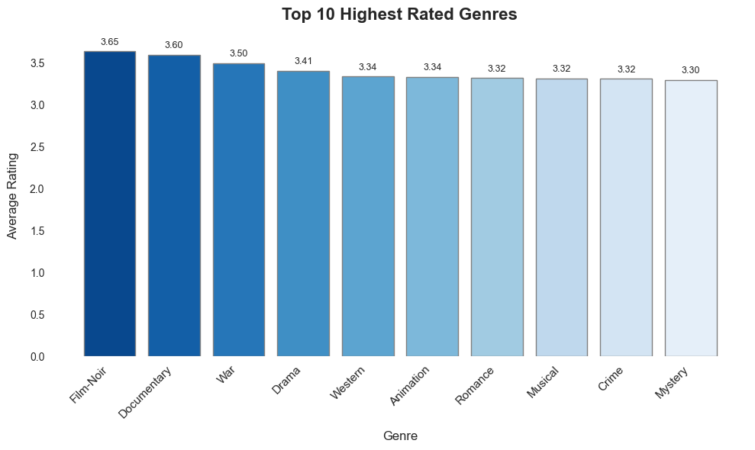





Film-Noir is the best-rated genre
What are the highest-rated genres?
Followed by:
Documentary
War
Drama

Slide 14
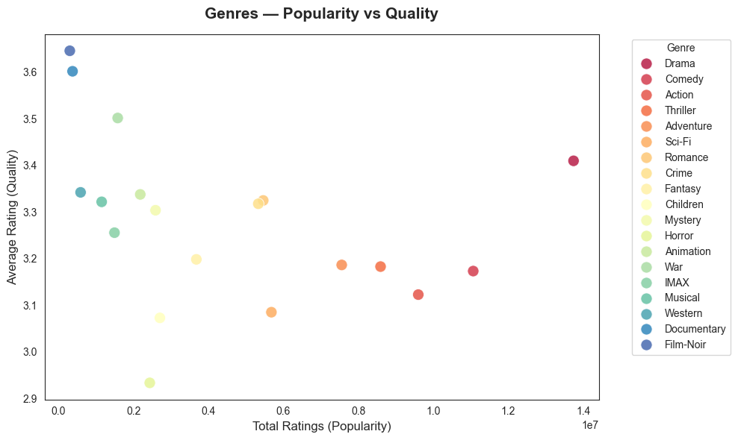
Popular genres are not necessarily the best rated
What is the relationship between popularity and quality?
Drama, Comedy, Action, and Thriller attract the largest audiences, but have mixed audience perception (~3)
Film-Noir, Documentary and IMAX receive fewer ratings, but have higher average scores
Niche genres tend to deliver higher viewer satisfaction

Slide 15
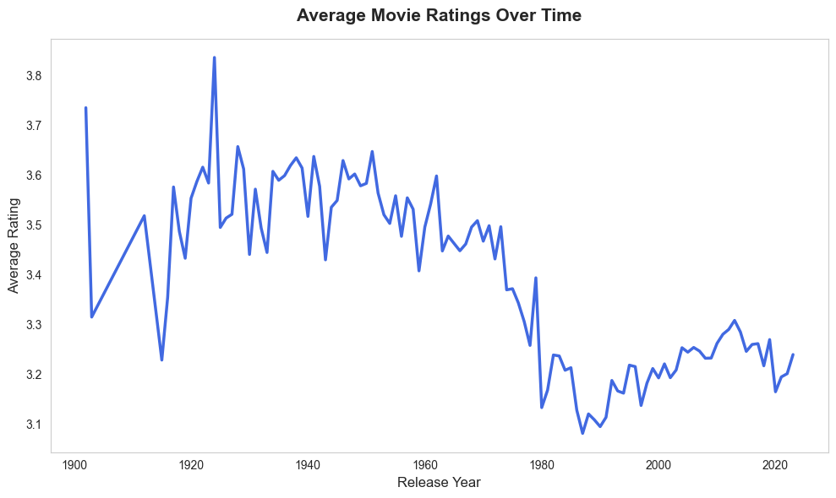
Quality suffered a decline in recent years
How have movie ratings evolved?
From the 1940s to 1970s, average ratings stabilized around 3.0-3.2.
From the 1970s to 2000s, average ratings declined, potentially due to increased movie accessibility.
In recent years, we see another decline coinciding with the COVID-19 times and the rise of streaming platforms.

Slide 16
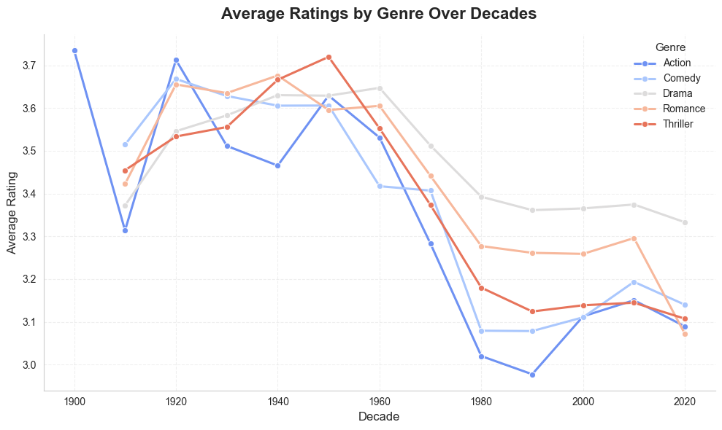
Cinema’s core genres continue to resonate with audiences over time
How have movie genres evolved over the decades?
The same declining appreciation trend is observed for individual genres.
Drama has the best appreciation since 1960s.
Action movies show sporadic peaks, coinciding with or following real-world conflicts.
Romance movies substantially declined during the past decade.

Slide 17
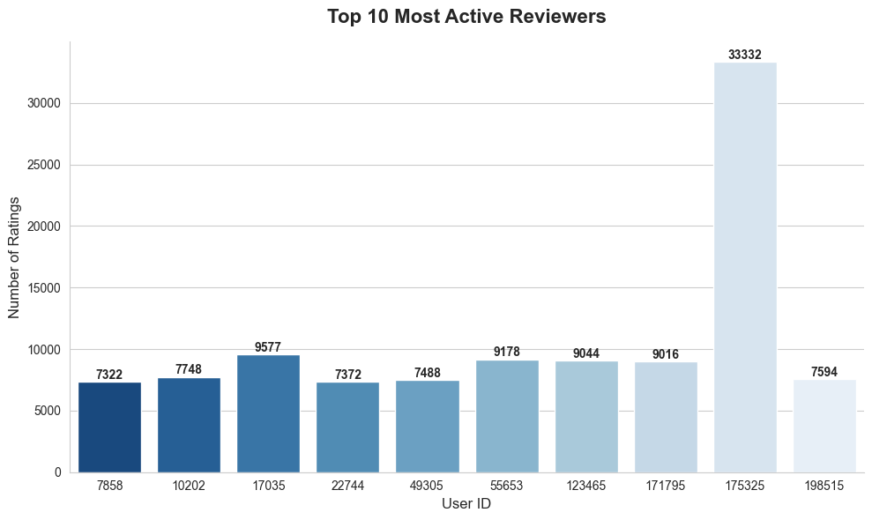
The most active user reviewed 3x more movies than 2nd place
Who are the most active reviewers?
User 175325 contributed with 33,332 movie ratings!
The other top 10 reviewers contributed with 7,322-9,577 movie ratings.
Analyzing the user allows tailoring personalized recommendation systems.
3x more!

Slide 18
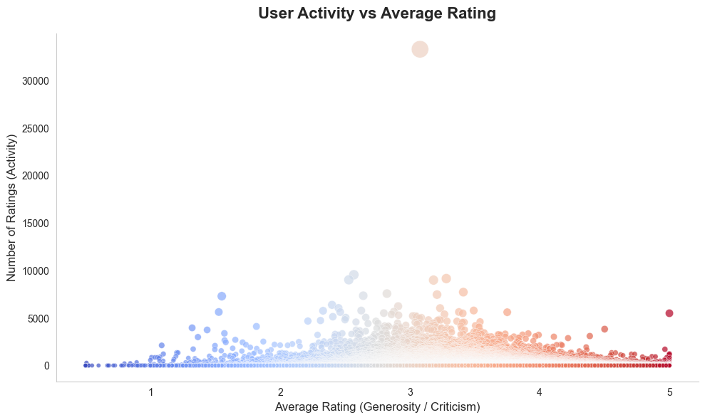
High activity does not imply greater criticism
Do the most active users tend to give higher or lower ratings?
Most users give average ratings between 2.5 and 4.0.
User activity is largely independent of rating bias.
IMDb has a balanced and consistent evaluation culture.

Slide 19
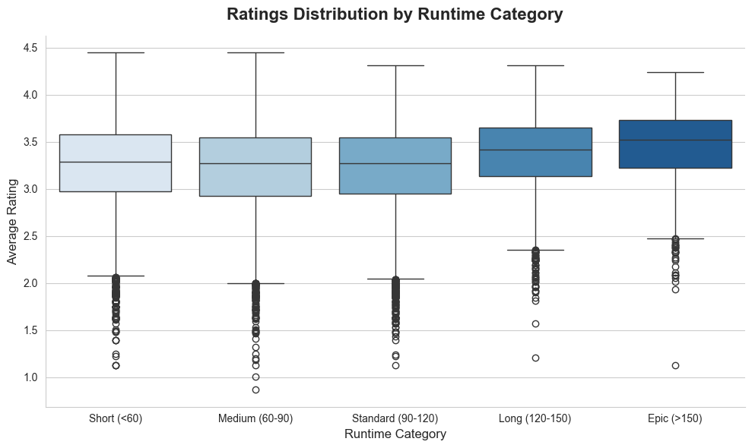
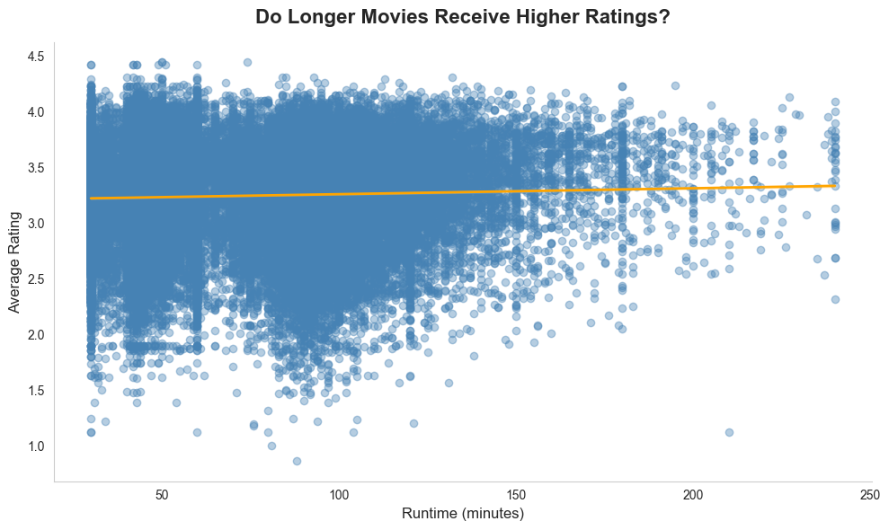
Audience appreciation thrives on narrative balance rather than sheer duration
Do longer movies receive higher or lower ratings?
IMDb’s runtime data:
Short (< 60min)
Medium (60-90min)
Standard (90-120min)
Long (120-150min)
Epic (> 150min)
Shorter movies have greater score variability.
Longer movies tend to have slightly higher average ratings, possibly due to richer storytelling and emotional complexity.
Excessive duration does not guarantee higher quality.

Slide 20
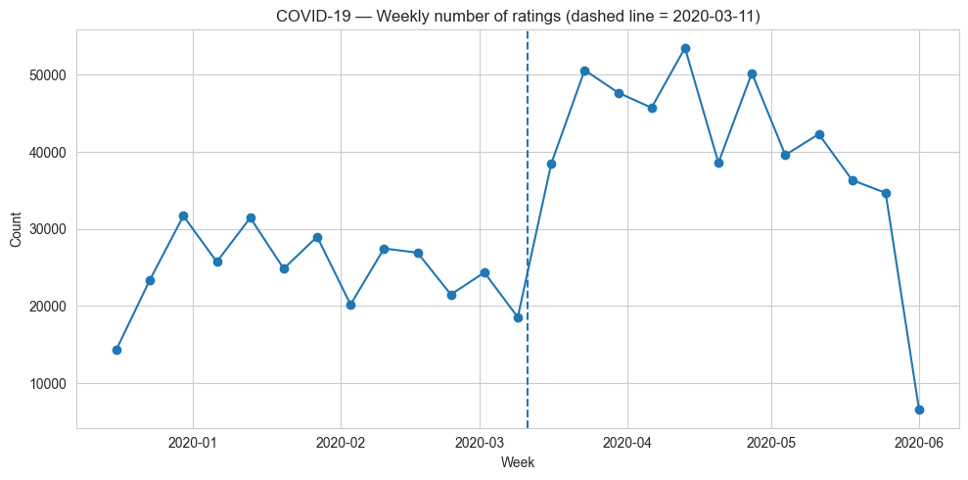
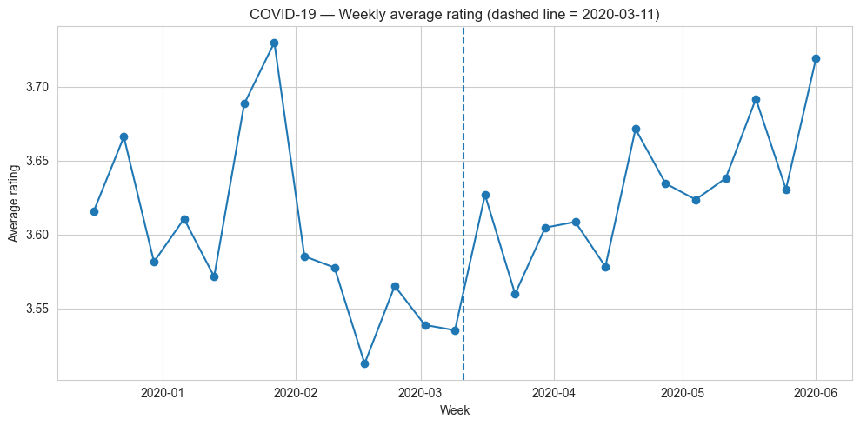
Weekly number of ratings increased during COVID-19
Did user behaviour change around the COVID-19 pandemic?
There was a sharp increase in weekly rating numbers.
The average ratings stayed stable.
People rated more movies, but evaluation standards remained the same.
Lockdown affected volume, not sentiment.

Slide 21
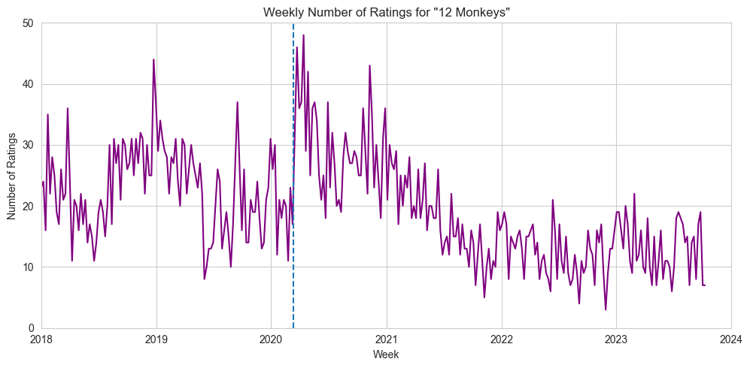
There was a slight spike in the 12 Monkeys movie ratings during the COVID-19 lockdown
Did people remember a movie with a COVID-like plot during the pandemic?
Description:
In a future world devastated by disease, (…) gather information about the man-made virus that wiped out most of the human population on the planet.
12 Monkeys is a movie from 1995 with the genres Mystery, Thriller, and Sci-Fi

Slide 22
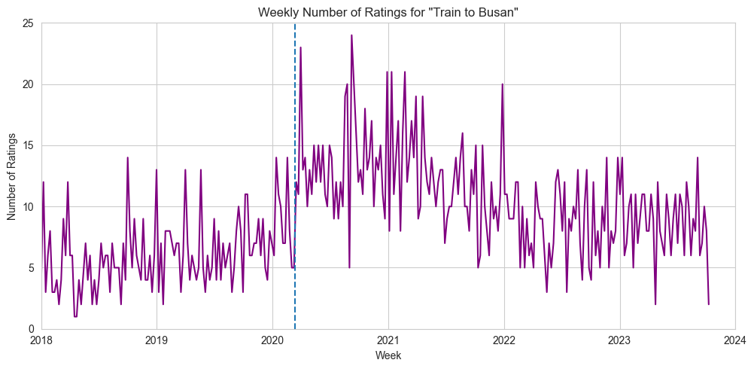
There was a slight spike in the Train to Busan movie ratings during the COVID-19 lockdown
Did people remember a movie with a COVID-like plot during the pandemic?
Description:
While a zombie virus breaks out in South Korea, passengers struggle to survive on the train from Seoul to Busan.
Train to Busan is a movie from 2016 with the genres Action and Thriller

Slide 23
2025
Thank you!
We’re now available for questions :)

